Slide 1

APPLICANT OUTREACH AND
ADMISSIONS INSIGHTS
Data-Driven Analysis of Recruitment, Engagement, and Case Progress
Team 11 | January 2026

Slide 2

Agenda
Dataset Overview
Key EDA Insights
Data Cleaning & Quality Improvements
Dashboard Walkthrough & Insights
Recommendations
Conclusion

Slide 3

Dataset Overview
7,543 records and 80 original variables
5,000 unique students
Variable Type: Categorical, Numerical & Date and Time
Focus on international graduate recruitment
High sparsity and repeated interaction records

Slide 4
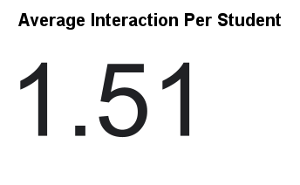
EDA Insights – Engagement
7,543 interactions across 5,000 students
Average of 1.5 interactions per student
Small group of high-touch applicants dominate engagement

Slide 5
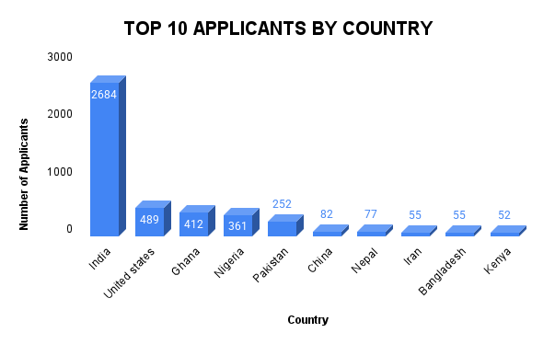
EDA Insights – Geography
India contributes over 60% of applicants
US, Ghana, Nigeria follow distantly
Opportunity to expand into underrepresented regions

Slide 6
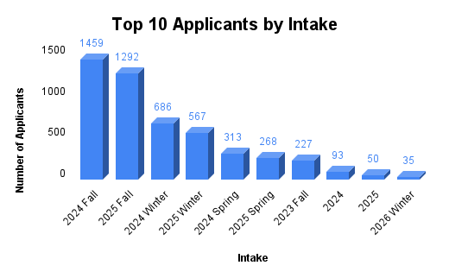
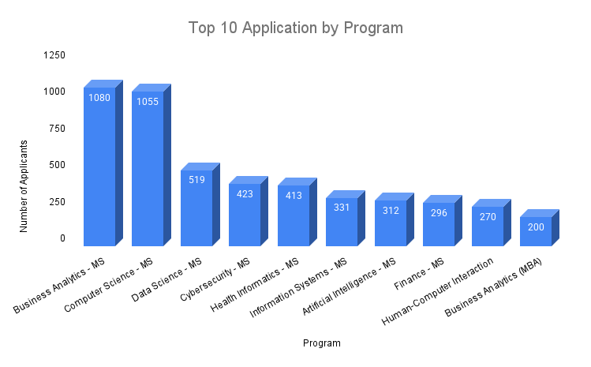
EDA Insights – Programs & Intakes
Business Analytics and Computer Science dominate
Strong Fall intake peaks
Spring and Winter intakes underutilized

Slide 7

Data Cleaning & Quality Improvements
Dropped 38 empty columns
Reduced dataset to 32 usable fields
Standardized categories and fixed date formats
Preserved duplicate Reference_IDs for interaction analysis

Slide 8
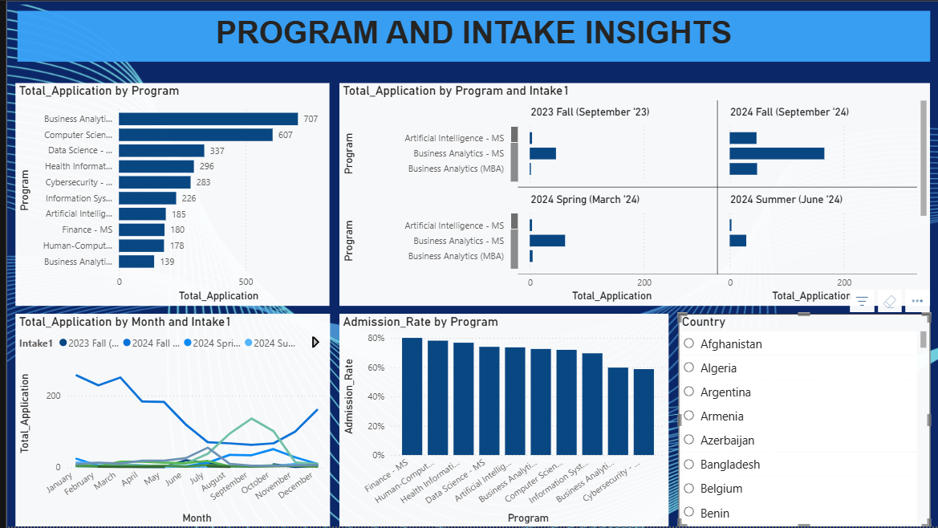
Dashboard Walkthrough
Country and college distribution
Outreach outcomes and counselor activity
Intake-based trends
Focus on engagement and case progress

Slide 9

Major Dashboard Insights
Follow-ups and missing transcripts dominate outcomes
Indicates engagement but slow resolution
Counselor activity varies significantly

Slide 10

Recommendations
Improve data completeness
Expand geographic outreach
Diversify college partnerships
Optimize case tracking
Balance counselor workload

Slide 11

Conclusion
Strong engagement but concentrated pipelines
Data cleaning enabled actionable insights
Better data leads to better admissions strategy

Slide 12


